Slide 1
Addis Ababa University
Department 0f Computer Science
Data Mining Project
Title: Supermarket Data Analysis Using Association Rule
Prepared by:
Eyasu Taye
Kalkidan Tesfaye,
Chala Bahru,
Bilise Mesele
Department of computer Science(AAU) June 2023.

Slide 2
Contents
Introduction
Motivation
Objectives
Methodology
Evaluation

Slide 3
Introduction
Supermarkets have large number of customers checking into the items and to know customers need its better to identify which products bought frequently, which products are bought together,and association between items.
Association rule mining is one of the principal problems treated in KDD and can be defined as extracting the interesting correlation and relation among huge number of transactions.
Frequent itemset is generally adopted to generate association rules. As the amount of data stored supermarket database grows twice as fast as the speed of the fastest processor available to analyse it. Main purpose of analysing frequent itemset is to find the association relationship among the large number of database items. It is used to describe the patterns of customers' purchase in the supermarket.

Slide 4
Motivation and Domain Description
Finding inhereherent regularities in data is motivation behind this supermarket data analysis project. Association rule mining is one of the technique to identify underlying relations between different items, it helps to identify which items of supermarket mostly bought together and their correlations.
For instance, if item A and B are bought together more frequently then several steps can be taken to increase the profit.
A and B can be placed together so that when a customer buys one of the product he/she doesn't have to go far away to buy the other product.
People who buy one of the products can be targeted through an advertisement campaign to buy the other one.
Collective discounts can be offered on those products, if the customer buys both.
Both A and B can be packaged together.
The process of identifying an associations between products is called association rule mining.
So we apply this rule as a data driven solution in the domain we are interested in.

Slide 5
Objectives
The objective of analysing supermarket transaction data is the identification of items that frequently occurring patterns, correlations, or associations from datasets found in the databases.

Slide 6
Methodology
To achieve our objectives discussed we use apriori association rule data mining algorithm. And the Apriori library we are going to use requires our dataset to be in the form of a list of lists, where the whole dataset is a big list and each transaction in the dataset is an inner list within the outer big list.
we perform data preprocessing, data analysis and data mining functions for extraction of interesting implicit, non-trivial, previously unknown, and potentially useful patterns from supermarket data transaction.
Data Preprocessing
Data cleaning
Data Reduction
Data Transformation

Slide 7
Continued..
Data Cleaning, Data Reduction, Data Transformation
The dataset has the following limitations
Incomplete and Null values
No header row is necessary
Unused column
Steps to clean the data
Make complete the data by inserting default value for null values.
Remove header option from the dataset since it is not necessary so the first row of the dataset can not be treated as header.
Remove unused column from the dataset
Transform the csv dataset to list data type
So we found that
Each row corresponds to a transaction and,
Each column corresponds to an item purchased in that specific transaction.

Slide 8
The dataset dimension
It means the dataset has
7500 rows
27 columns

Slide 9
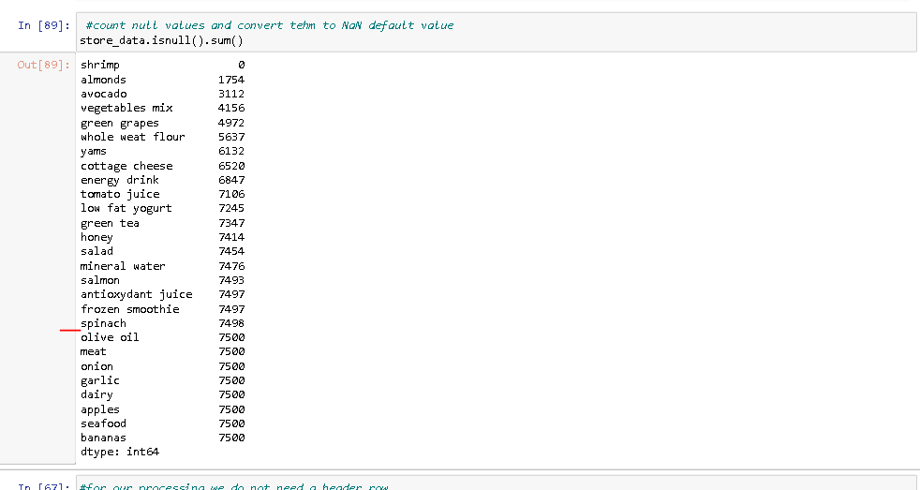
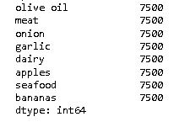
Columns which are no more important in the dataset
Are not important for our objectives
Must be removed.

Slide 10
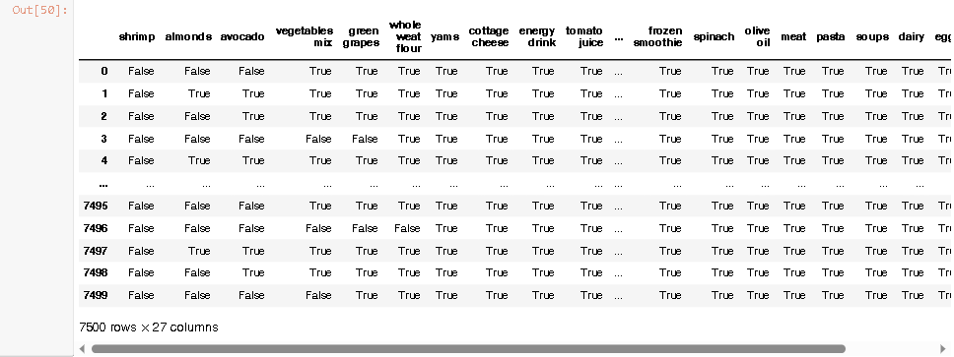
The first row as a header
The first row is treated as a header, must be transformed to normal row
True = The value is null
False = The value is not null

Slide 11
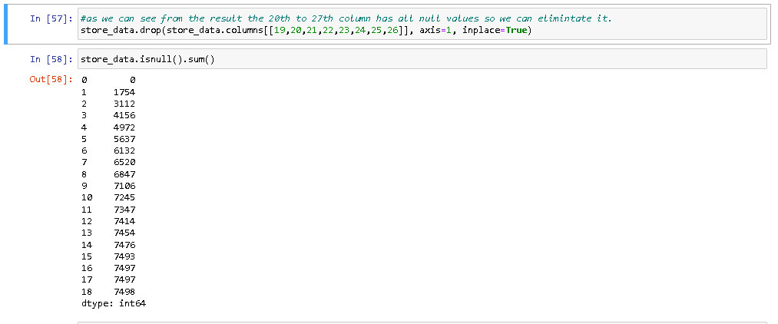
Data reduction by removing irrelevant columns
8 Columns are
Removed

Slide 12
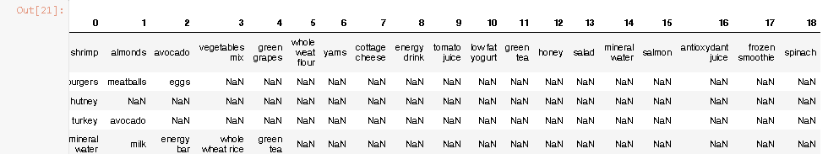
Null values are transformed to NaN default value
A header row is removed
Null is transformed to NaN value
A header row is removed
Null is transformed to NaN value
* Now the dataset is clean enough

Slide 13
continued..
Data Analysis
The apriori class requires some parameter values to work.
The first parameter must be list of list that to extract rules from.
The second parameter is the min_support parameter.
The min_confidence parameter.
The min_lift parameter specifies the minimum lift value for the short listed rules.
Finally, the min_length parameter specifies the minimum number of items that you want in your rules.

Slide 14
continued..
Data Analysis
The apriori class requires some parameter values to work.
We want to create rules for items purchased five times a day in one week
That means 7*5 = 35 times per week
The support = 35/7500 = 0.0045
Let Minimum confidence = 20% or 0.2
Lift = 3
Min length = 2

Slide 15

Evaluation
First rule:
The support value is 0.0045. This number is calculated by dividing the number of transactions containing light cream divided by total number of transactions.
The confidence level for the rule is 0.2905 which shows that out of all the transactions that contain light cream, 29.05% of the transactions also contain chicken.
The lift of 4.84 tells us that chicken is 4.84 times more likely to be bought by the customers who buy light cream compared to the default likelihood of the sale of chicken.

Slide 16

Evaluations Continued…
Second rule:
The second rule states that mushroom cream sauce and escalope are bought frequently
The support for mushroom cream sauce is 0.0057.
The confidence for this rule is 0.3006 which means that out of all the transactions containing mushroom, 30.06% of the transactions are likely to contain escalope as well.
Lift of 3.79 shows that the escalope is 3.79 more likely to be bought by the customers that buy mushroom cream sauce, compared to its default sale.

Slide 17
Conclusion
Association rule mining for supermarket dataset has been presented, Mining has been applied to sales data of dataset. In proposed project, the apriori algorithm has been used on super market dataset which gives associations of two products which has maximum support, It reduces the size of the itemsets in the database considerably providing a good performance. Thus, data mining helps consumers and industries better in the decision-making process.

